Slide 1



Automation
Infrastructures
Do’s and Dont’s
Yossi Rosenberg
Gett

Slide 2

About Me: WWW
Who am I?
Why am I here?
Why am I developing automation and not a software developer ?
Yossi Rosenberg
Gett
Automation infrastructures don dont’s

Slide 3
During this journey we will answer some questions
How much time spent using a “bad” infra on development time + maintenance efforts ?
What is the right formula to develop a successful infrastructure ?

Slide 4
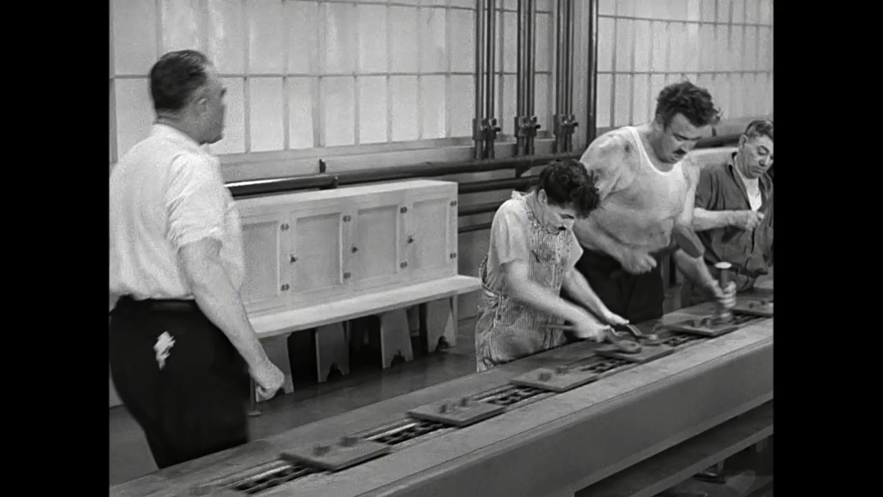

Slide 5

Divide and Conquer
A very big mass multinational mass media company.
Tagging & processing a massive amount of data each minute.
Automation infrastructures were develop separately for each testing field.

Slide 6
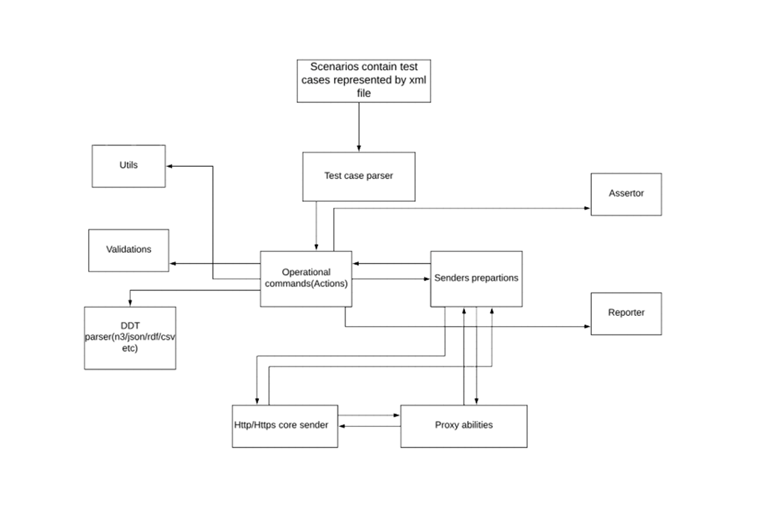
API Automation infrastructure – short overview
VIEW
GENERAL
CONTROLLER
GENERAL
MODEL
CORE

Slide 7
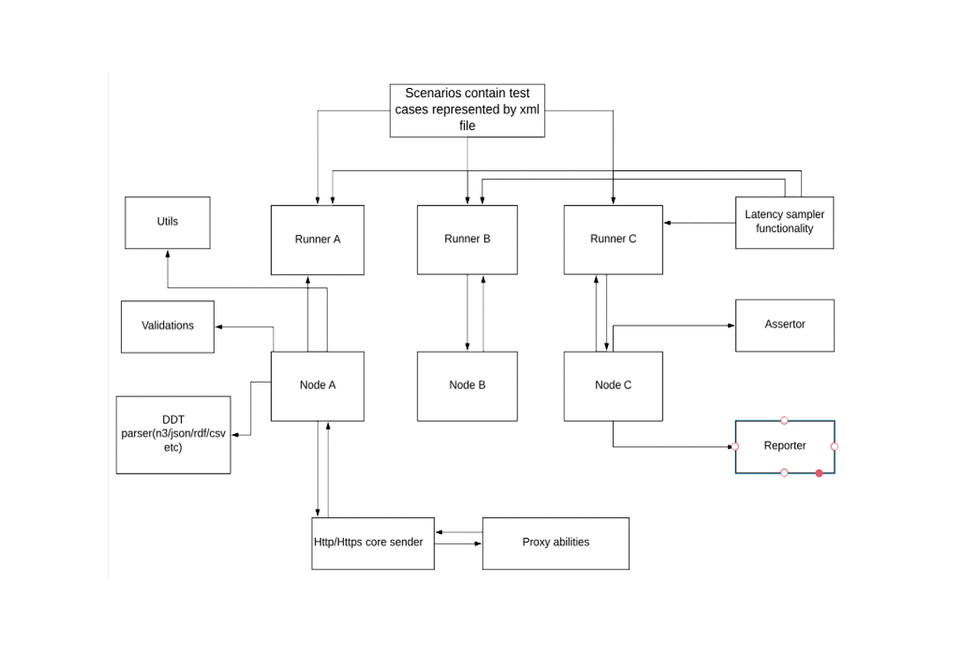
API Automation infrastructure – short overview
VIEW
What’s wrong here?
GENERAL
GENERAL
CONTROLLER
MODEL
CORE
Yossi Rosenberg
Gett

Slide 8
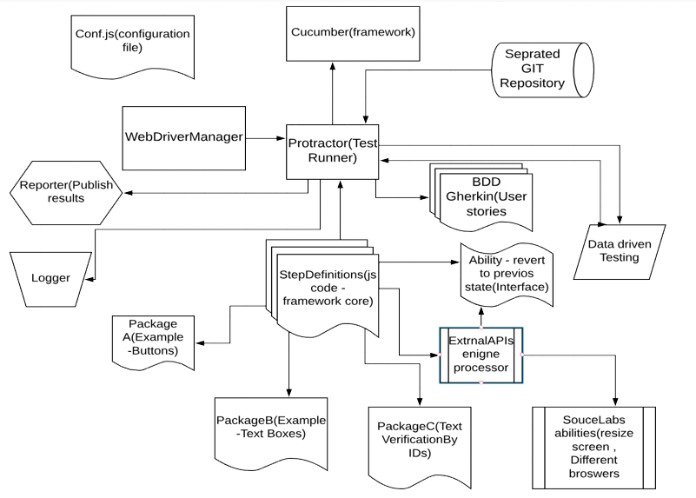
UI INFRASTRCTURE EXAMPLE (BDD based)
And What’s wrong here?
s
et
Automation infrastructures do dont’s

Slide 9
MVC – C - G
Model – The automation infrastructure “heart”.
View – The infrastructure’s input layer.
Controller – The “runner”, basically runs and control the whole infrastructure.
Core – Separated from the traditional model – why?
General – General utilities
oi Rosenberg
t

Slide 10
Pros
Possible to develop each automation on another programming language.
Build failures due to an infrastructure core/model issues of one infrastructure doesn’t affect other infrastructures(we don’t put our all eggs into 1 basket).
Fast coding(no need to consider on other domains).
oi Rosenberg
t

Slide 11
Cons
Falling into the “weak runner” trap makes it harder to fit the MVC-C-G Model.
Difficult to have a proper knowledge sharing while working on 4 infrastructures.
Between these infrastructures a standalone utilities have to be developed to fill in some gaps that falling between the cracks.
Hard to differentiate between Model and General layers.

Slide 12

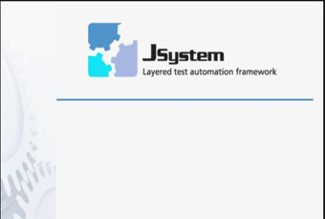
The Many and The Few
Big semiconductors industry company
Testing on a multi disciplinary systems. The optics ,hardware and software need to run together and be synchronized.
The real challenge is to run the automation on both simulator and a real “breathing” machines.
Desktop GUI testing Java swing based.

Slide 13
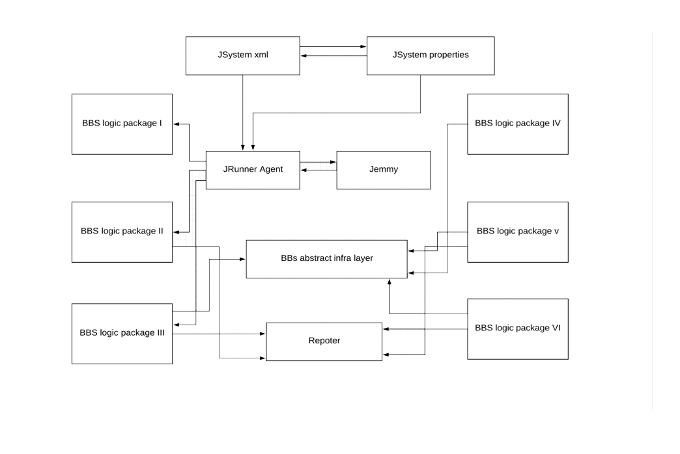
Many Testers – Few Developers
VIEW
MODEL
MODEL
CONTROLLER
MODEL
GENERAL

Slide 14
Pros
Fast development process.
Easy to develop - manual qa testers can compose a test just by drag&drop Building Blocks of code without even know how to code at all.
Easy to maintain – fixing the code on the building block layer.

Slide 15
Cons
Very shallow way of testing, can’t dive too deep.
Very hard to run automation on real machines.
Never hard code anything and if you do don’t dare to push it.
Core layer embedded inside the model layer.
Test relevancy issue, need to monitor test relevancy all the time in order to save space on the nightly shards and tester’s time analyzing the failures. Can you think of any solution for that?

Slide 16
Tests Relevancy solution
Using sonar to catch duplications which IDE missed to spot.
Hard code review. (pass mr/pr to each other).
Documentation – Documentation – Documentation.

Slide 18

O. One infrastructure to rule them all
Moving from an old infra into a new one, switching from Junit + JSystem to our own infrastructure testNG based.
Dedicated infrastructure team developing the infrastructure.
Have to support all kind of testing : mobile + web + API.
Ad dont’s

Slide 19
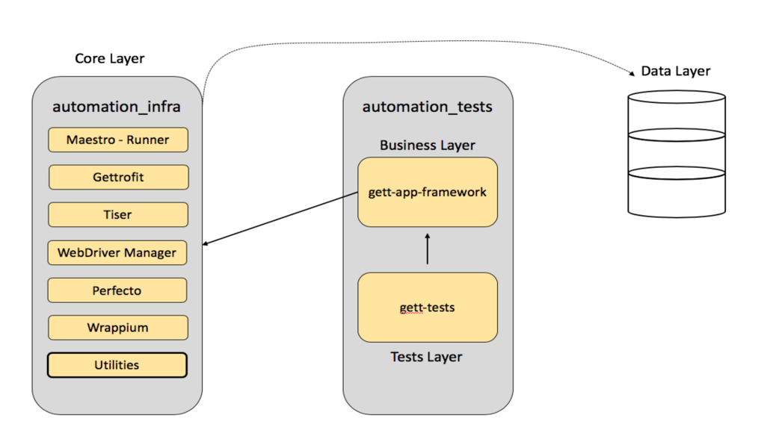
O. One infrastructure to rule them all
Rosenberg
G
Automation infrastructures and dont’s

Slide 20
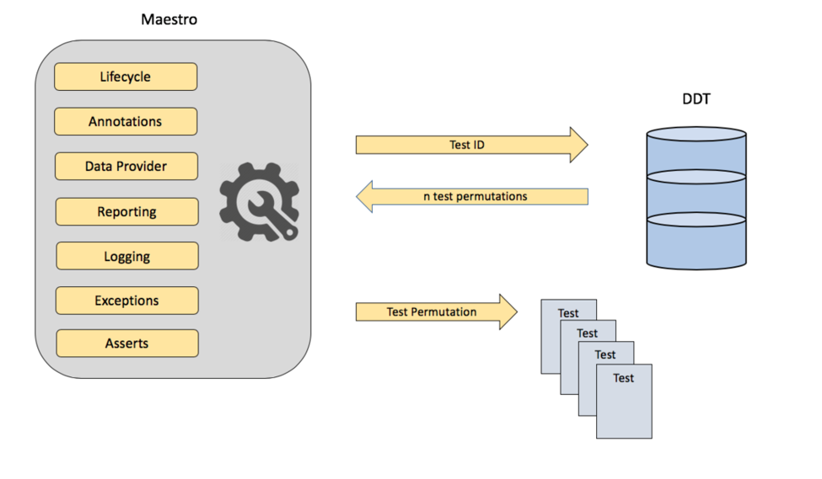
O. One infrastructure to rule them all
Automation infrastructures d’s and dont’s

Slide 21
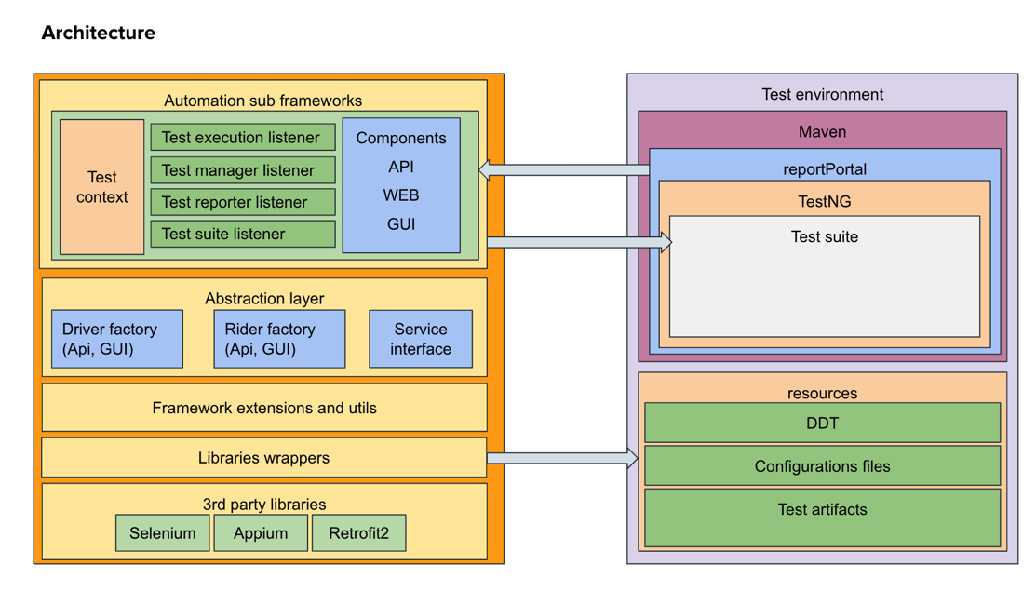
O. One infrastructure to rule them all
Rosenberg
Get
dont’s

Slide 22
Pros
Full Collaboration and knowledge sharing between all automation teams (cross scrum development).
General utilities, DB business and other logics are mutual.
Possibility to develop an e2e flow. On separated infrastructures a Jenkins multijob/bash files have to run in order to run an e2e flow.
High Code standards (java format, sonar, ci).
Yossi Rosenberg
Gett

Slide 23
Pros
Possible to run with only one runner job on the ci/cd.
Generics! Generics! Generics! it makes the infra 10 times more powerful.
Easy reporting mechanism.
It is the right move to admit that time has come and we need to build a new infra.

Slide 24
Cons
From the testers side – big dependency on the infra team.
Might be hard to maintain , need to consider all domains on every fix.
Long development process time while developing the infra itself
Don’t use more than one layer of abstract.

Slide 25
So, which method of infra developing is the right one?
There is no absolute Truth

Slide 26

So, which method of infra developing is the right one?

Slide 27

Thank you
Please stay in touch
Yossi.Rosenberg@gett.com
LinkedIn: Yossi Rosenberg
Yossi Rosenberg
Gett

